Slide 1
Waste Impact Calculator:
Context and Concepts
Notes:
Hi, I’m Martin Brown from the Oregon Dept. of Environmental Quality, and in this video I’m going to tell you about the questions and ideas behind the Waste Impact Calculator model.

Slide 2
Notes:
WIC converts what we know about solid waste – how many tons of stuff are going to what sorts of places – and figures the life cycle environmental impacts for that stuff.
Why would you want to know that?

Slide 3
Notes:
You’ve probably heard a lot about the kind of things that are in solid waste or what you should do with it.
You might have heard waste used in the same phrases with words like consumption, throwaway, recycling, pollution, etc. [word cloud]
You might have heard advice like “recycle plastic straws” or “reduce food waste” and be wondering why it matters.

Slide 4
Notes:
I personally break the problems with waste down into two categories:
Direct effects of litter
Environmental impacts of materials.
These are both real and important phenomena, but they are different.

Slide 5
Notes:
DIRECT EFFECTS OF LITTER
This is probably most of what you’ve heard about. Plastic in the ocean. Animals getting fouled, eating plastic, etc.
This happens because plastic gets in to the ocean.
In Oregon, this is not really a problem. The majority of plastic in the ocean comes from…

Slide 6
Notes:
ENVIRONMENTAL IMPACTS OF MATERIALS
The other way waste is bad is less obvious but just as important. Whenever you’ve got waste, it represents a lot of stuff that has happened.
For example, my glass jar.
Mined
We call this
THE MATERIALS LIFE CYCLE

Slide 7
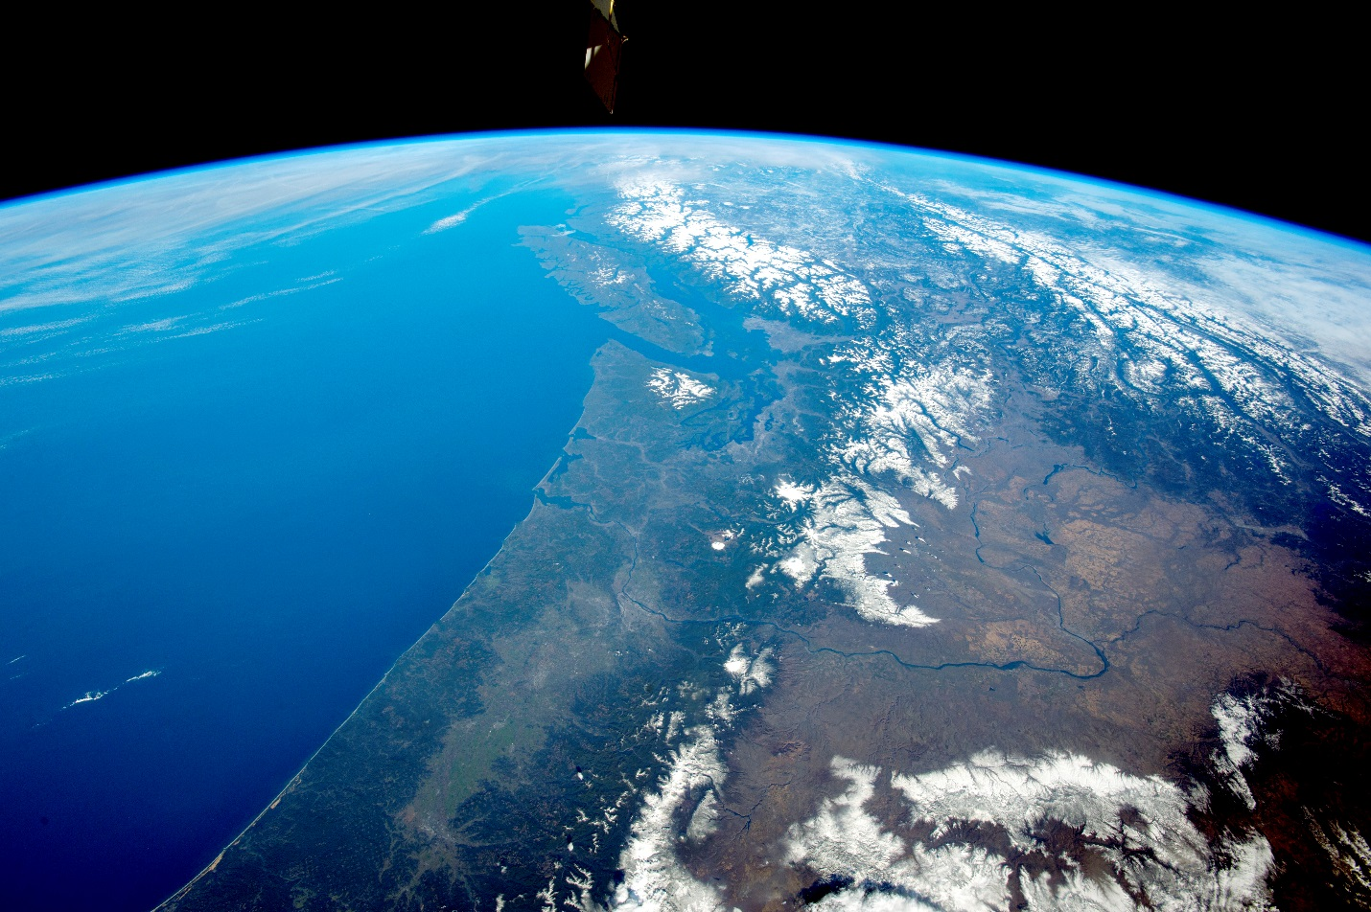
Intro to the Waste Impact Calculator

Slide 8
A change in perspective

Slide 9
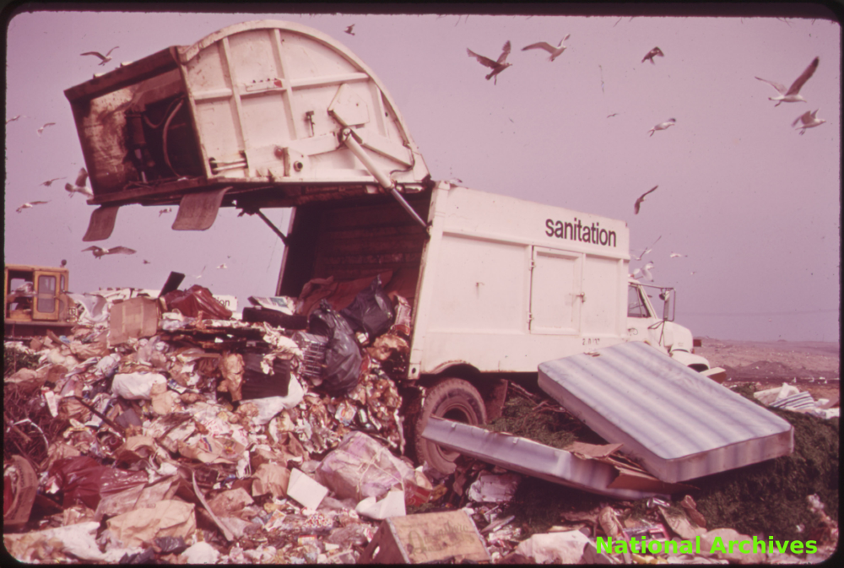
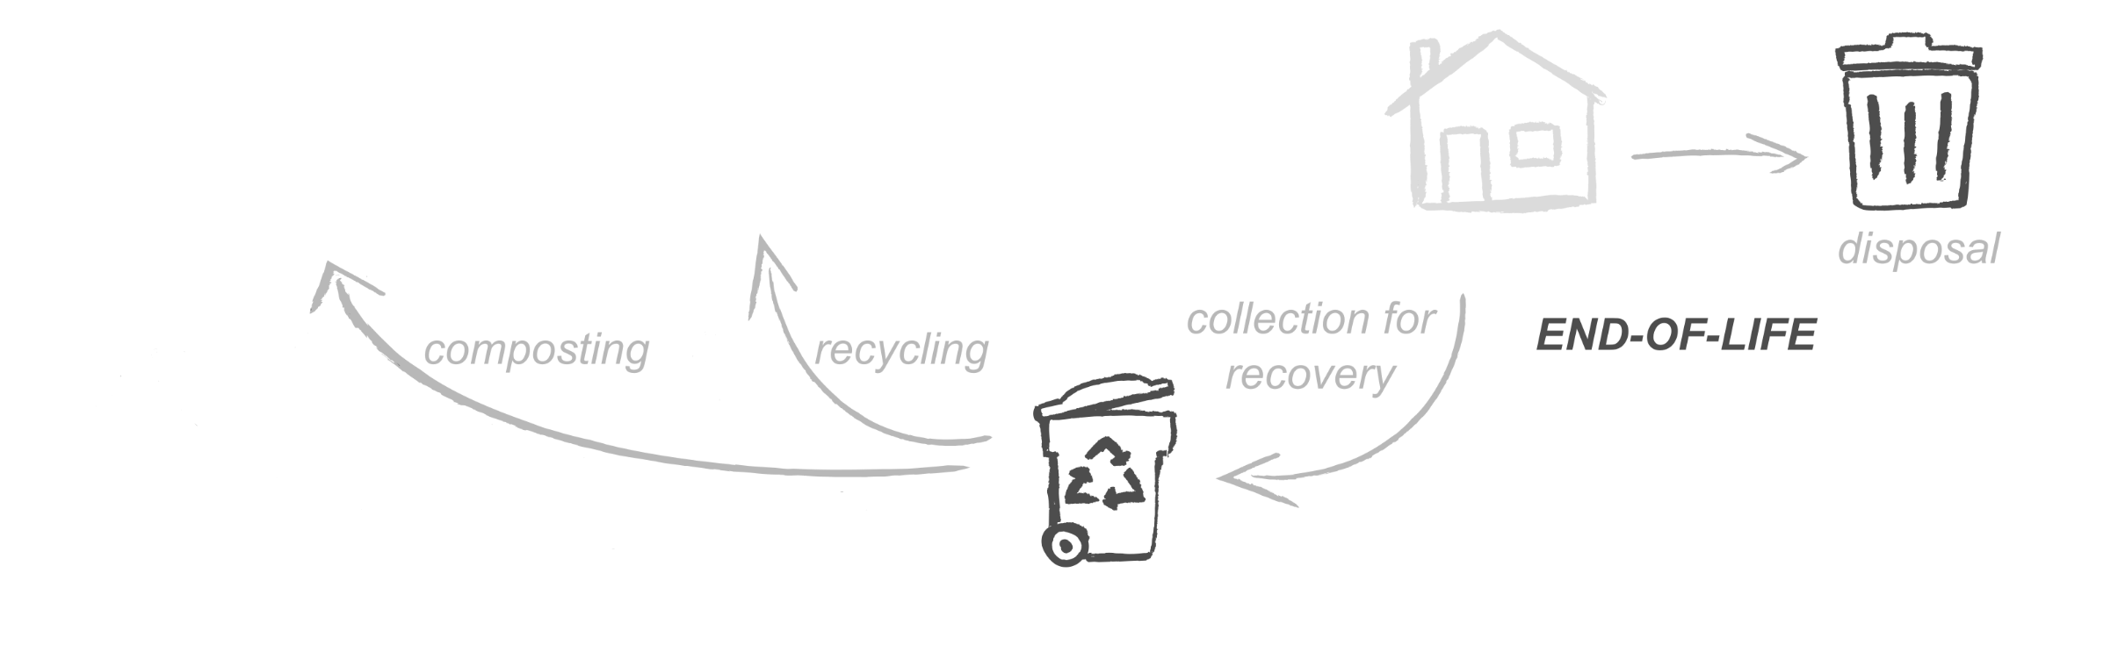
From managing solid waste…

Slide 10
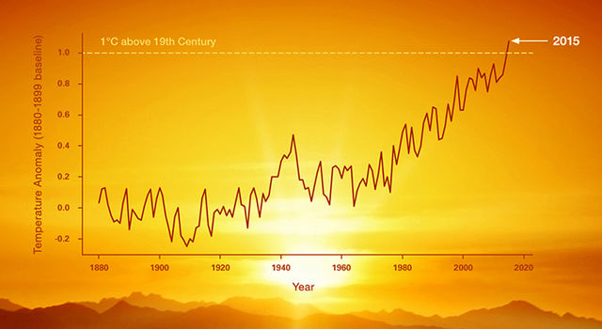
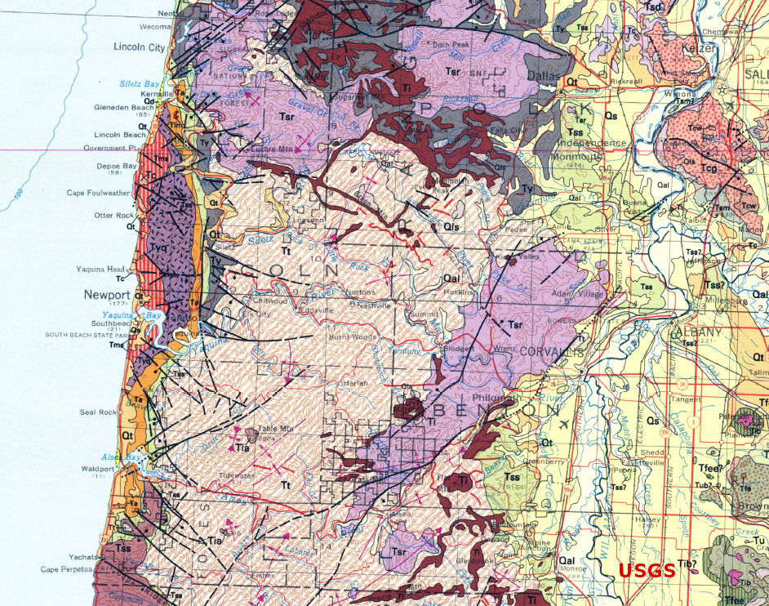
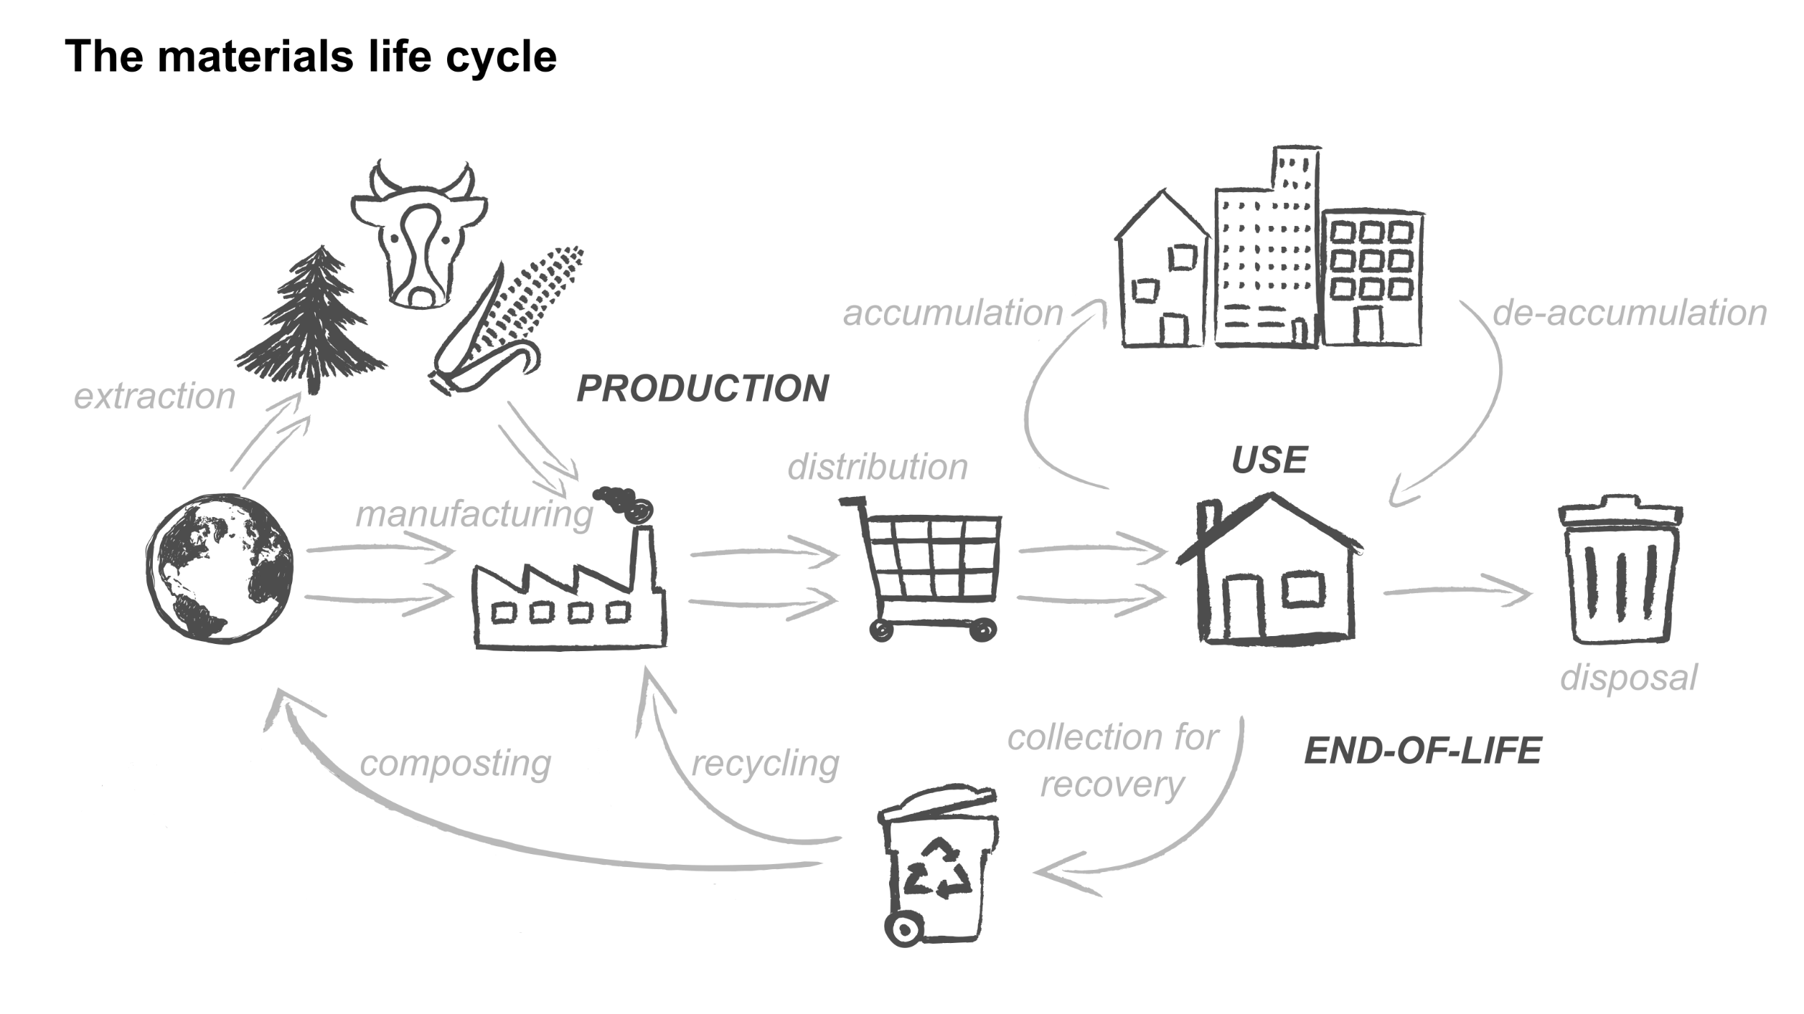
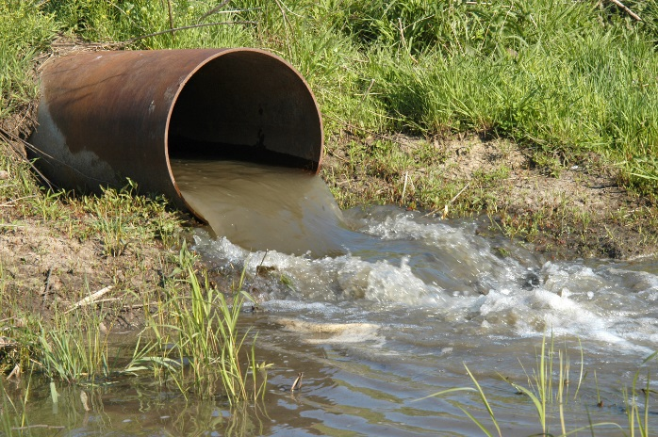
… to reducing impacts over the materials life cycle

Slide 11
Waste Impact Calculator bridges the gap

Slide 12
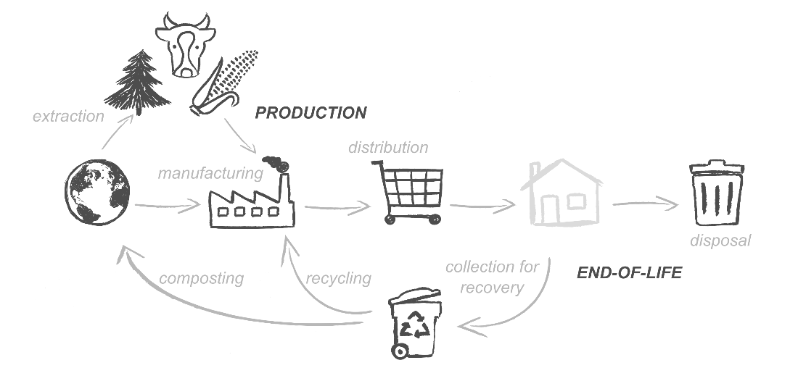
Idea: use solid waste data to calculate impacts

Slide 13
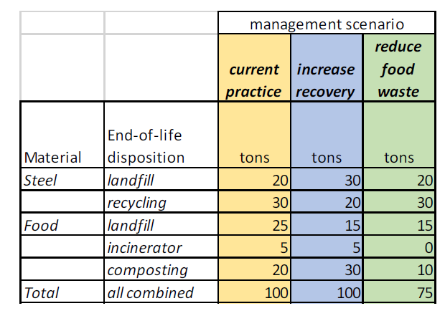
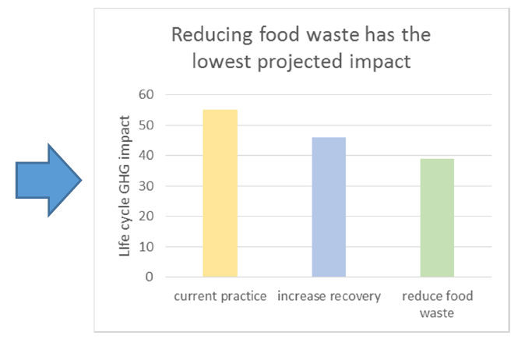
Here’s the basic idea
You start with solid waste data
The calculator changes it into impacts
The calculator lets you come up with alternative ways of managing solid waste and estimate their impacts

Slide 14
Let’s try it!

Slide 15
Important things to remember

Slide 16
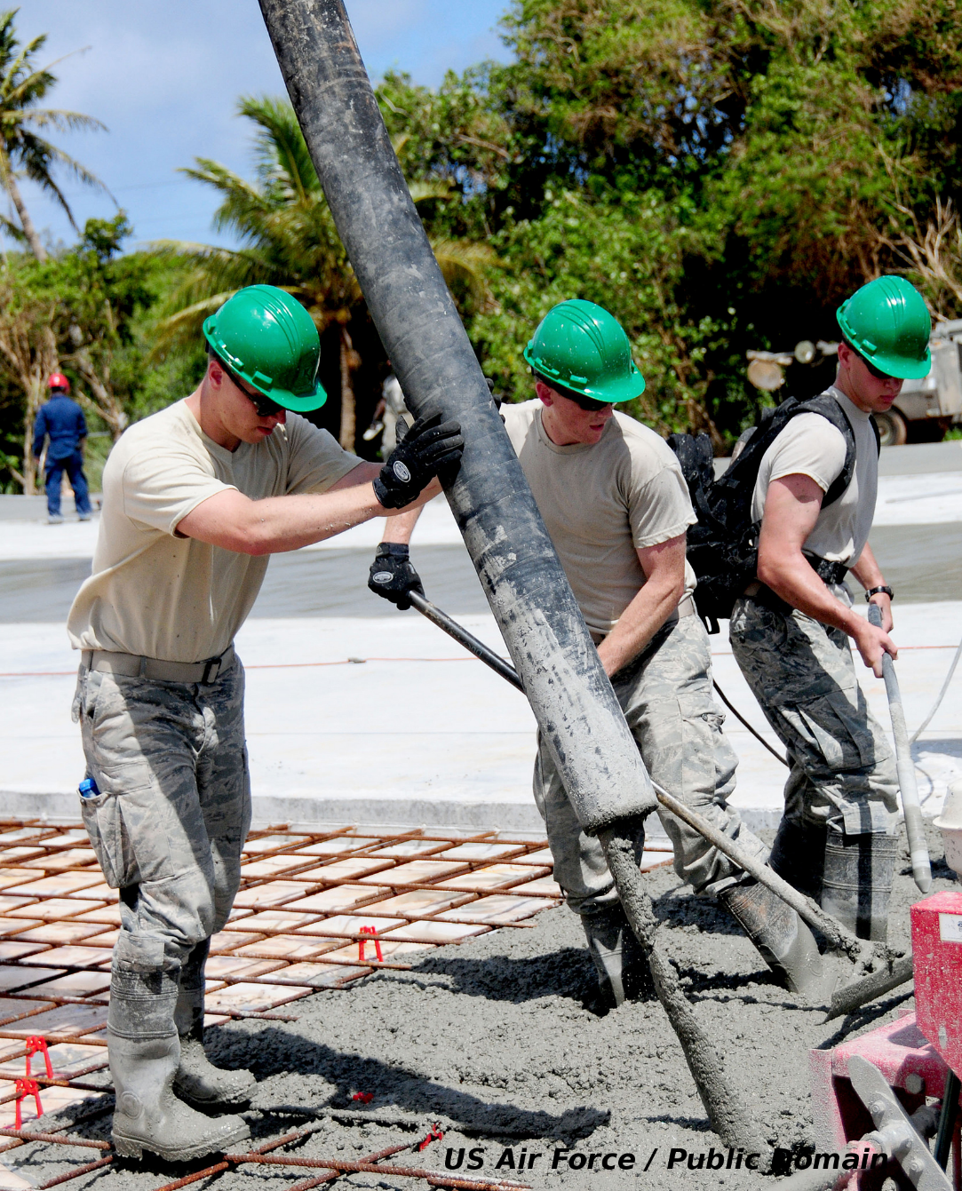
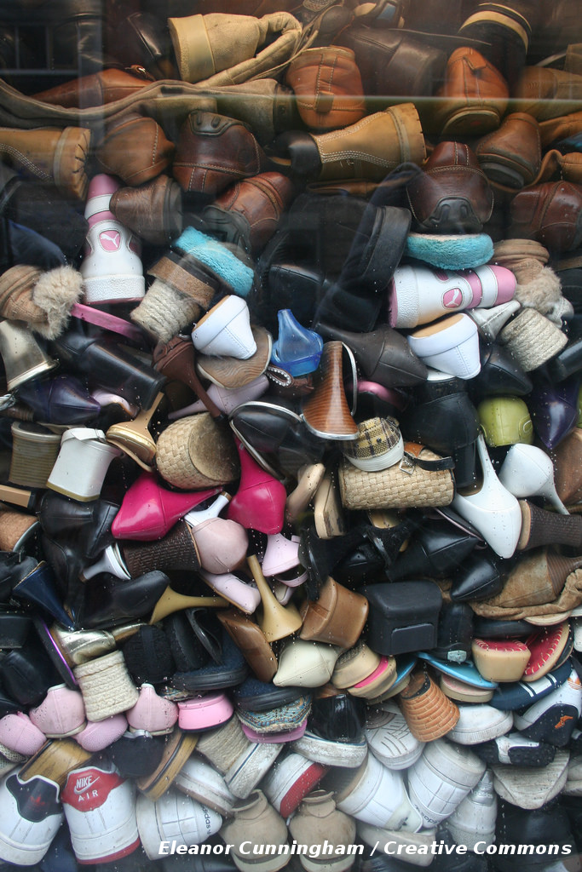
Solid waste represents < half the impact of materials!

Slide 17
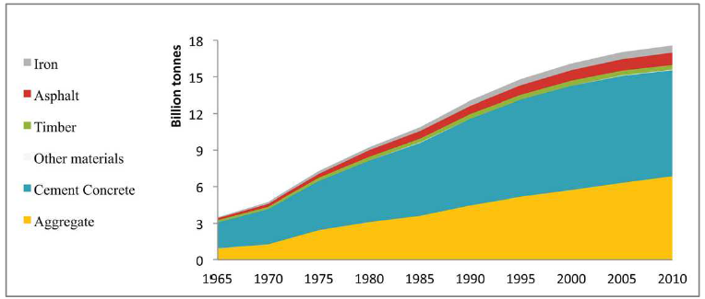
The scale of non-waste accumulation can be astounding
Growth of urban infrastructure in Japan (from Tanikawa et al, Journal of Industrial Ecology 19:778-791)

Slide 18
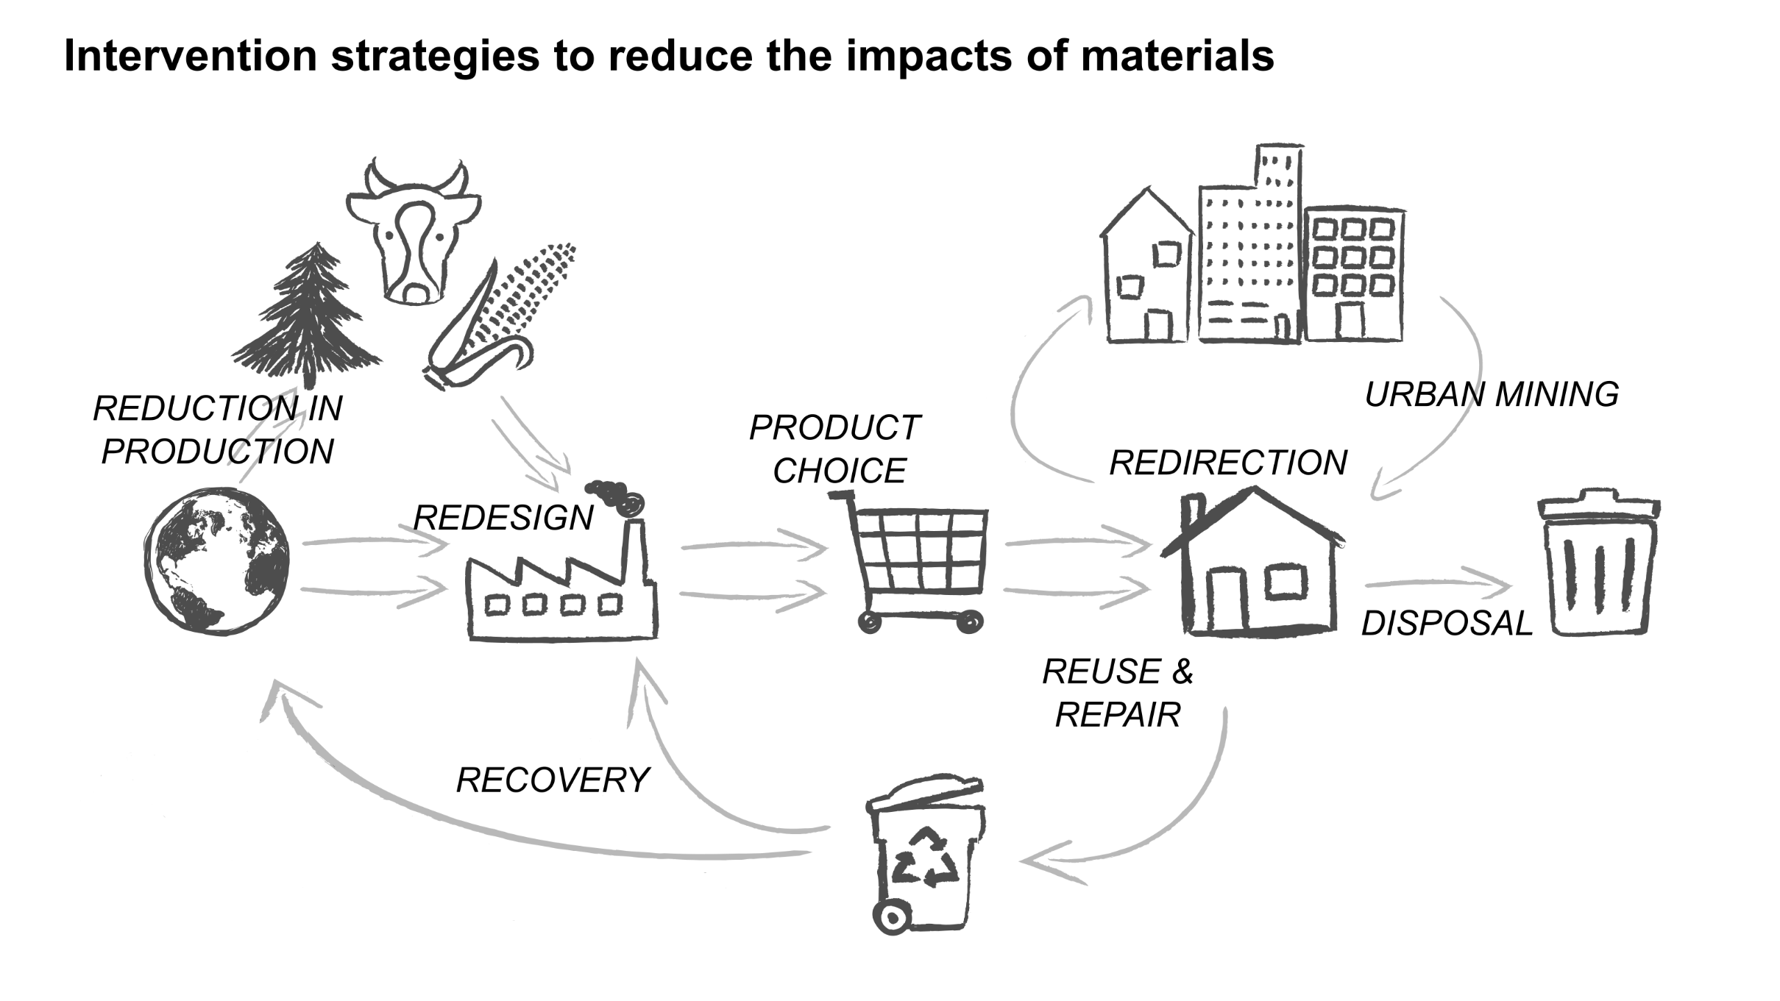
There are lots of ways to reduce the impacts of stuff

Slide 19
Thanks! Martin.Brown@state.or.us

